Slide 1

WORK COOPERATIVELY IN A GENERAL ADMINISTRATION ENVIRONMENT
D1.HGE.CL7.13 D1.HGA.CL6.02
Notes:
Trainer welcomes trainees and informs them that they will be learning how to work cooperatively in a general administration environment.

Slide 2

Subject Elements
This unit comprises three Elements:
Develop effective team relationships
Participate in team assignments
Contribute to team development
Notes:
Trainer advises this Unit comprises three Elements, as listed on the slide explaining:
• Each Element comprises a number of Performance Criteria which will be identified throughout the class and explained in detail
• Trainees can obtain more detail from their Trainee Manual
• At times the course presents advice and information about various protocols but where their workplace requirements differ to what is presented, the workplace practices and standards, as well as policies and procedures must be observed.

Slide 3

Assessment
Assessment for this unit may include:
Oral questions
Written questions
Work projects
Workplace observation of practical skills
Practical exercises
Formal report from supervisor
Notes:
Trainer advises that assessment for this Unit may take several forms all of which are aimed at verifying they have achieved competency for the Unit as required.
Trainer indicates the methods of assessment that will be applied to them for this Unit.

Slide 4

Element 1:
Develop effective team relationships
Notes:
Introduce topic.
Class Activity – General Discussion
Ask general questions:
What is a team?
What is the purpose of a team?
What types of teams exist?
What are characteristics of teams?

Slide 5
Develop effective team relationships
Performance Criteria for this Element are:
Develop and maintain relationships with team members and promote benefits of cooperative work consistent with organisational goals and objectives
Undertake responsibilities and assignments in a positive manner to promote effective relationships within the work group
Notes:
Trainer identifies the Performance Criteria for this Element, as listed on the slide.

Slide 6
Develop effective team relationships
Performance Criteria for this Element are:
Conduct courteous and appropriate communication with others in a manner which reflects sensitivity to individual social and cultural differences in accordance with organisational requirements
Use appropriate communication techniques to relay information in a clear and concise manner
Notes:
Trainer identifies the Performance Criteria for this Element, as listed on the slide.

Slide 7
Develop effective team relationships
Performance Criteria for this Element are:
Use language and tone appropriate to a particular audience, purpose and situation, taking into account the relevant factors involved
Recognise and discuss issues that may lead to, or involve conflict with team members, or refer to appropriate persons
Complete routine workplace documentation accurately in a timely manner
Notes:
Trainer identifies the Performance Criteria for this Element, as listed on the slide.

Slide 8
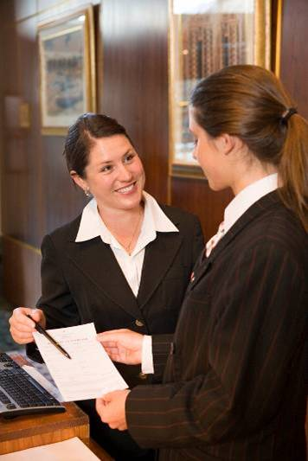
Teamwork
Teamwork is classified as the collective actions towards a number of people towards a collective goal.
In a hospitality or tourism organisation, no one person can meet the needs of all customers.
It requires the collective efforts of many people to achieve success.
Notes:
Discuss the concept of a team.
Class Activity – Questions
What is teamwork and how is it developed?

Slide 9
Teamwork
Whilst each business will have a range of goals, in essence the primary goal is to:
Provide an enjoyable experience for customers
For a reasonable return on investment
In a safe and lawful manner
Notes:
Discuss the above points.

Slide 10
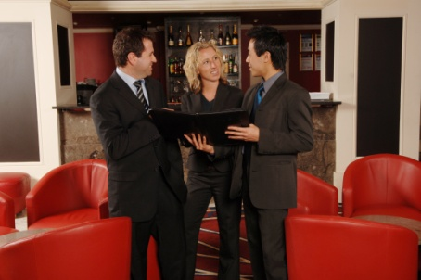
Team
A team is often characterised through:
Having a common goal
Work interdependently
Independent job functions
Enjoy working
Accountability
Empowerment
Understand the importance of teams
Notes:
A team is often characterised through:
Having a common goal – it is important all staff not only identify the goal, but why it is important
Work interdependently with each other – the actions of one person impacts other staff
Independent job functions – whilst staff are working together, they perform different roles and have different activities. Staff must understand how their actions contribute to the greater good of the team
Enjoy working together – this may be hard with different personalities, however in most cases people enjoy working together. Get staff involved in activities where they can find out more about each other
Accountability - staff will not only have their own responsibilities, but will also have collective responsibilities
Empowerment – staff have their own power to act and make decisions
Understand the importance of teams.

Slide 11
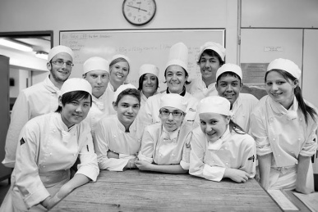
Team
Factors influencing team structure
Teams are commonly created based on a number of factors including, but not limited to:
Organisational structure
Purpose of the business
Company culture
Types of departments
Degree of service provided
Service style
Notes:
Discuss impacts of team structure
Trainer to show or explain organisational structures for different styles of hospitality businesses.

Slide 12
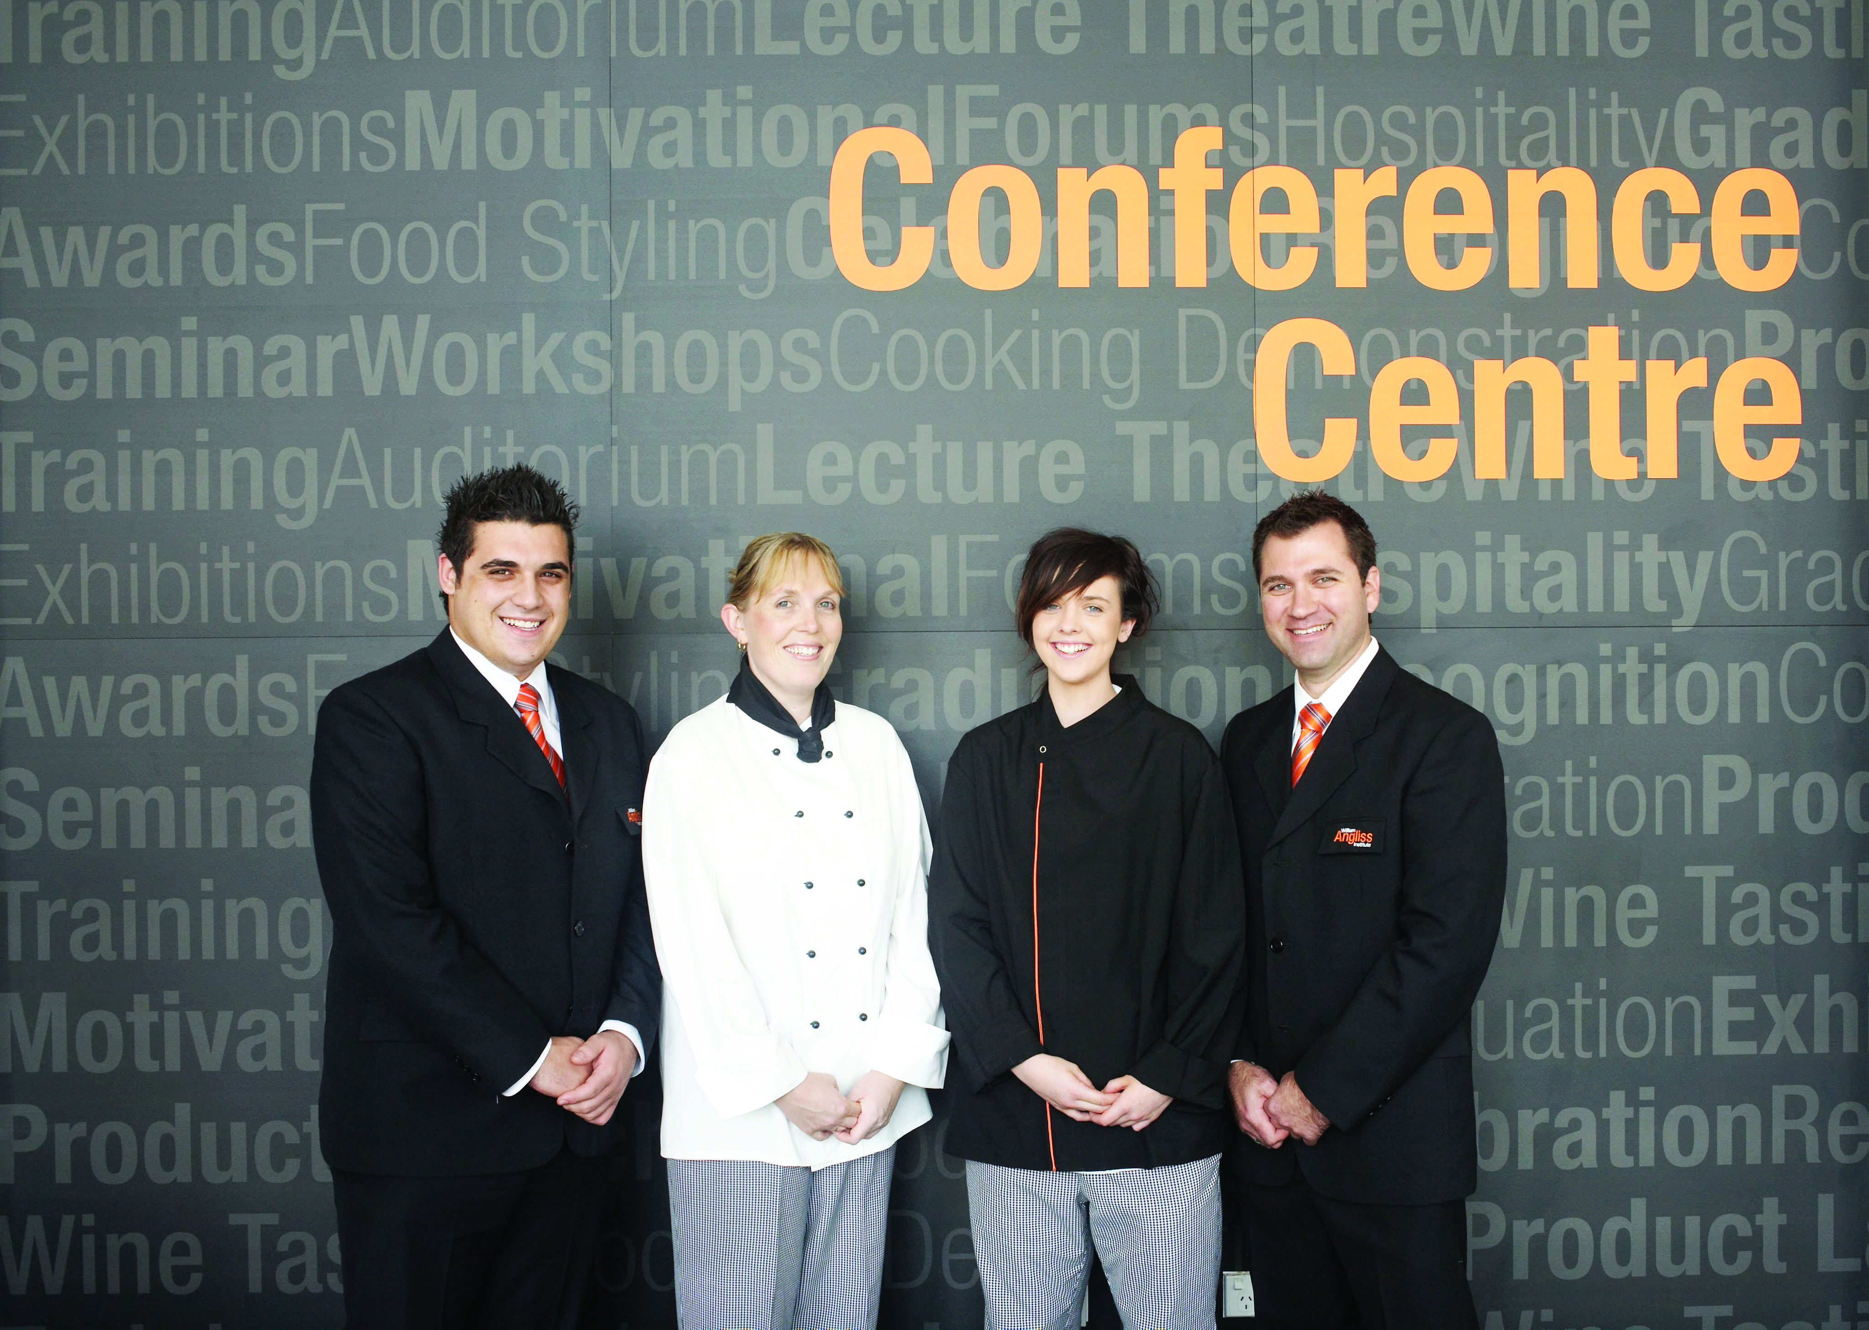
Types of teams
The organisation as a whole
Individual branches
Individual work sections
Specific groups of employees assigned to complete designated tasks, or to work together
Notes:
Discussion
Discuss the different types of teams and how they are formed.

Slide 13
Context for Front Office
Workers in the Front Office need to be aware:
People see Front Office as the nerve centre of the business
They are expected to be efficient and effective in gathering and disseminating information
It is critical to develop a good working relationship with all other venue departments
Front Office plays an important role as a central ‘clearing house’ for establishment information
Notes:
Discussion
Discuss role of Front Office as a ‘clearing house’ for information.

Slide 14
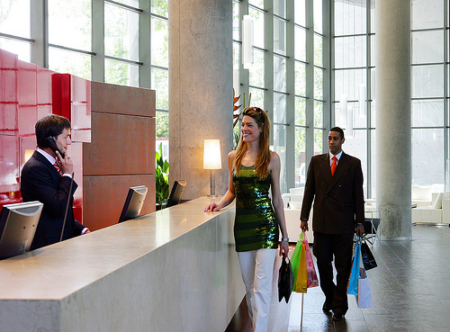
Team purpose and responsibilities
Regardless of the size, structure or dynamic of each group, they will always have a purpose and responsibilities in which they strive to achieve.
Notes:
Discussion
What are possible purposes and responsibilities each team will have?

Slide 15

Team purpose and responsibilities
Types of responsibilities
Targets, goals and objectives
Reporting deadlines
Meeting budgetary targets
Team participation
Team and individual learning goals
Professional development
Notes:
Discussion
Discuss the importance of these responsibilities?
What other ones may exist?

Slide 16

Purpose of work groups
A team is brought together to serve a purpose. This purpose normally has defined objectives or goals in which it is aiming to achieve
In order to achieve these goals, each person within the team will have set roles and responsibilities in which they are expected to understand and undertake
Notes:
Discussion
What roles and responsibilities does each team member have towards meeting overall team goals?
How are these defined?
What are the advantages and disadvantages of having work groups?

Slide 17

Workgroups
Workgroups
A workgroup is the most common structure for people to work together
A workgroup is one where people have a common ground for working
Individuals are given a specific set of responsibilities and roles or tasks that when the individual efforts are put together, creates a total output
Notes:
Discussion
How are group members made aware of the responsibilities and assignments?

Slide 18
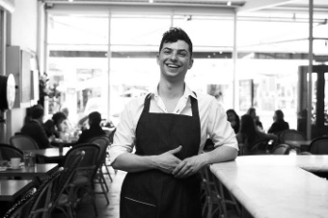
Responsibilities
Team and individual responsibilities
Each work team, whether as a whole or as individual members, have responsibilities that must be adhered to.
What are these responsibilities?
Notes:
Discussion
What are these responsibilities?

Slide 19

Responsibilities
Work team tools
Work teams use a variety of tools to create the best harmony and work output including:
Checklists
Position descriptions
Team leader roles
Authority rules and procedures
Focus on heightening socialisation
Notes:
Discussion & Review of documents
Discuss these tools
Trainer to provide examples of each for the audience to review.

Slide 20
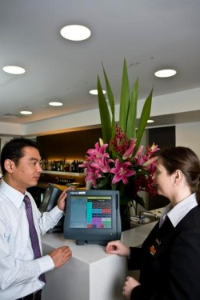
Importance of communication
When providing support to others, especially when sharing knowledge it is vital that you have good communication skills
It is no point providing verbal support, it the recipient does not understand what you are trying to say, or if the message is communicated incorrectly
It is important that all of these communications are conducted in a polite, professional, clear and concise manner
Notes:
Class Activity – Questions
How can you provide polite, professional, clear and concise information?

Slide 21
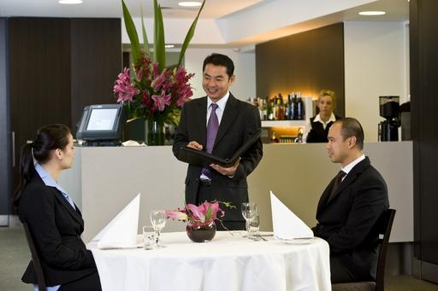
Valuing customers and colleagues
The hospitality and tourism industries are leading examples of multicultural industries
Many workplaces are staffed with people from various cultures
Staff interact with and serve people from different nations and cultural backgrounds
Notes:
Class Activity – General Discussion
Trainer leads a general class discussion how diverse a hospitality environment is
Staff - What diversity exists in your business in regards to staff? What countries do they come from? What different cultures exist?
Customers - What diversity exists in your business in regards to customers? What countries do they come from? What different cultures exist? What languages do they speak?

Slide 22

Social and cultural differences
There are a number of things that make us all different including:
The way they live
Language
Traditional practices and observations
Values and principles
Educational background
Sporting interests
Notes:
Class Activity – General Discussion & Exercise (incorporates this and next slide)
Discuss the diversity of the audience in relation to these points. Write the answers down on the board.
You will find a great amount of diversity just amongst this group. Imagine the expanse of diversity given all the staff and customers in a typical hospitality business.
Given the list you have developed, what can a hospitality business do to help cater to these cultural differences?

Slide 23

Social and cultural differences
Food and beverage tastes
Lifestyle background
Place of birth
Styles of communication
Dress code
Religious or spiritual beliefs
Cultural stereotypes
Conventions of gender, sexuality and marriage
Notes:
Class Activity – General Discussion & Exercise (incorporates this and past slide)
Discuss the diversity of the audience in relation to these points. Write the answers down on the board.
You will find a great amount of diversity just amongst this group. Imagine the expanse of diversity given all the staff and customers in a typical hospitality business.
Given the list you have developed, what can a hospitality business do to help cater to these cultural differences?

Slide 24
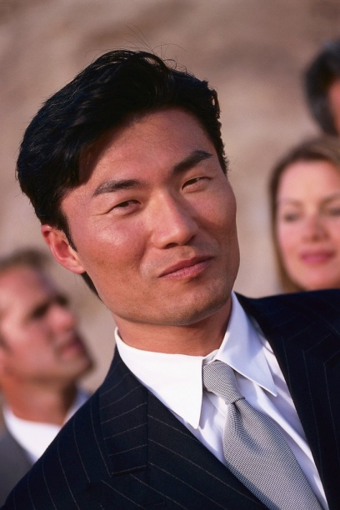
Different cultural groups
Colleagues and customers come from all corners of the globe including:
ASEAN countries
Other Asian countries
European Community countries
Middle Eastern countries
Subcontinent Countries
North and South American countries
African Countries
Oceania Countries
Notes:
Class Activity – List and discuss
Identify different countries located within the geographical areas listed in this slide
For each country identify some cultural characteristics and needs
Identify how a hospitality business can cater to these needs.

Slide 25

Communicating in a diverse environment
Working in a socially diverse environment necessitates communicating with people from different cultural and social backgrounds.
Ensure that the two components of communication are appropriate to the person and culture being communicated with:
Verbal language
Body language
Notes:
Class Activity – Discussion
How do you use verbal language to communicate?
How do you use body language to communicate?

Slide 26

Communicating in a diverse environment
Verbal and non verbal communication
Keys in factoring in appropriate verbal and non-verbal communication when dealing with people from another culture include:
Identify the country and culture
Take time to plan what to say and how to say it
Be mindful of your body language
Avoid industry and establishment jargon
Notes:
Class Activity – Discussion
Provide examples for each point in this slide and how they can easily cause communication problems
Provide examples of how these can be applied correctly for effective communication.

Slide 27

Communicating in a diverse environment
Verbal and non verbal communication
Avoid local expressions
Avoid complex statements
Give the person your full attention
Use alternative communication strategies to support the verbal communication
Be alert to feedback from the other person
Notes:
Class Activity – Discussion
Provide examples for each point in this slide and how they can easily cause communication problems
Provide examples of how these can be applied correctly for effective communication.

Slide 28

Organisational requirements
Each organisation will also have a range of requirements that must be followed when undertaking general communication with both colleagues and customers.
What is purpose of having requirements?
What requirements must be followed?
Notes:
Class Activity – Discussion
Discuss the questions in the slide.

Slide 29
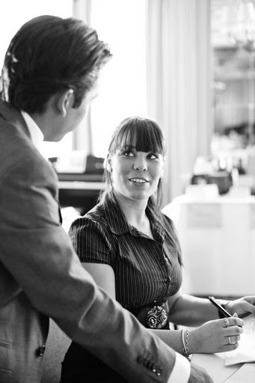
Use appropriate communication
In the previous section, we have explored the role of communication in a diverse environment made up of people, whether customers or colleagues, from different social and cultural backgrounds
This section will explore the different types of communication that can be used in a general administration environment
Notes:
Class Activity – Discussion
How do we communicate?
What are the different types of communication?
What are some tips to remember to make communication clear and concise?

Slide 30

Types of communication
Basic communication options include:
Verbal
Written format
Non-verbal
Use of an interpreter
Notes:
There are a variety of communications mediums used in the industry. Some may be specific to a particular establishment or industry sector, and others are quite general across all industry types and venues.
The basic communication options include:
Verbal –including face-to-face communication and talking on the phone. This also embraces the use of languages other than English and the use of Indigenous languages
Written format – which includes electronic mail and hard copy communications such as letters, signs, labels, posters and advertising and warning material
Non-verbal – facial expressions, gestures, sign language
Use of an interpreter to interpret verbal and printed language.

Slide 31

Effective communication
To help ensure your communication is polite, professional and friendly, the following tips will assist:
Follow all establishment policies
Use a person’s name where it is known
Be honest
Use ‘please’ and ‘thank you’ a lot
Notes:
To help ensure your communication is polite, professional and friendly, the following tips will assist:
Follow all establishment policies regarding communication with customers and colleagues. These may exist for greeting customers, interacting with staff and answering the phone
Use a person’s name where it is known
Be honest – but be sensitive, tactful, caring and respectful
Use ‘please’ and ‘thank you’ a lot.

Slide 32

Effective communication
Don’t interrupt
Speak at an appropriate pace and volume
Make sure your non-verbal language matches the verbal communication
Notes:
Don’t interrupt
Speak at an appropriate pace and volume – don’t’ yell, don’t whisper
Make sure your non-verbal language matches the verbal communication you are sending. This commonly means smiling when it is appropriate to do so, and displaying a serious demeanour when something serious is being discussed.

Slide 33

Written communication
Use graphics or pictures
Use different languages
Easy to read
Encourages people to read it
Be available in ‘take away’ form
Notes:
This means that in some instances, written communication may need to:
Use graphics or pictures to help clarify meaning
Be produced in a language other than English
Be printed in a font that is easy to read and in a print size that encourages people to read it
Be available in ‘take away’ form so that people can take a copy with them to read later and or in more detail.
Class Activity – General Discussion & Review
Discuss ways written communication can be improved in a hotel.
Audience to collect and discuss examples different businesses do to enhance their message through written documentation

Slide 34

Communication
Communication involves sending and receiving messages via:
Verbal communication
Non-verbal communication
Notes:
Class Activity – General Discussion
What is the difference between verbal and non-verbal communication?
Which one is more effective and why?

Slide 35
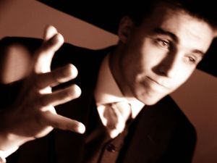
Verbal communication
Verbal communication includes:
Language or speech
Questioning, listening and answering
Notes:
Discuss the above points.

Slide 36

Listening
The use of questions and effective listening are keys in nearly all effective two-way communication.
What is the difference between ‘hearing’ and ‘listening’?
Are you are good listener?
Notes:
Discuss points.
If someone is a good listener, what makes them a good listener?

Slide 37

Effective listening
Encourages others to fully transmit their message by indicating our interest and concern
Ensured receiver has all the relevant facts
Improves relationships
Assists in problem resolution
Proper understanding between people
Reduces many conflicts
Improves staff morale
Raises workplace productivity
Notes:
Discuss points.

Slide 38

Questioning
What is the importance of questions?
When should you use them?
What types of questions can you ask?
Notes:
Discuss the questions on this slide.

Slide 39

Closed questions
Closed questions are asked in such a way as to elicit only a ‘Yes’ or ‘No’ answer.
When is a good time to use closed questions?
Notes:
Class Activity – General Discussion
Get the audience to identify times and to develop a list of suitable closed questions they could ask to a variety of scenarios.

Slide 40

Open questions
These are questions that probe the talker for more information and encourage them to supply further detail.
They are questions that begin with:
What
Why
How
Where
When
Notes:
Class Activity – General Discussion
Get the audience to develop a list of suitable open questions they could ask to a variety of scenarios.
In teams get audience to continue a conversation just using open questions, with the aim of not actually answering a question. This will make audience members to think about possible questions they could ask.

Slide 41

Non-verbal communication
Non-verbal communication includes:
Body Language
Facial expressions
Eye contact
Gestures
Posture
Notes:
Discuss each point identifying how these can be used to relay a message.
Class Activity – Activity
Get the audience to demonstrate a range of different communications using each of the points mentioned in this slide to depict a range of emotions.

Slide 42

Non verbal communication
Non-verbal communication is anything other than words that communicates a message.
The way we stand
The way we talk
The clothes we wear and the accessories we use
Our facial expressions
Notes:
Discuss point.
Class Activity – General Discussion
For each of the points identify different ways you can use this non-verbal communication to give different messages.

Slide 43

Non verbal communication
Five aspects of non-verbal communication:
Emblems
Illustrators
Affect displays
Regulators
Adaptors
Notes:
Major aspects of non-verbal communication
Five distinct aspects of non-verbal communication have been identified.
Emblems
These are the explicit type of gestures/body language that are used with complete intention, and whose meanings are generally accepted and understood.
Examples are:
Cupping the hand to the ear to indicate ‘I can’t hear you’
Holding the forefinger vertically in front of the lips to indicate ‘Shhh, be quiet’.
Illustrators
These are mannerisms that are unique to individuals.
They are what people do when talking. They are used to reinforce the verbal message they are sending.
They are usually related to the use of the hands, but they also include things that mark a person’s speech, such as the way one person may end a sentence, pauses in their speech, and emphasises words.
While these mannerisms are individualistic, the people are usually not aware that they do them until they see themselves on video-tape or hear themselves on audio-tape.
Affect displays
These are the ways in which our facial expressions or our body movements reveal our emotions.
In everyday life, people tend not to monitor or intentionally control their affect displays. Their true emotions are allowed to show.
In certain workplace situations however, staff may be required to display emotions that are contrary to their real feelings.
This is the case where staff are primarily and have customer-contact that requires them to smile all the time and present themselves as happy and nice when they may even feel the opposite.
Regulators
Everyone expresses themselves using regulators.
They are behaviours such as:
Nods
Stance
The direction and the duration of someone’s gaze
Vocal pitch
Raised eyebrows
The position/inclination of the head.
These behaviours regulate the verbal message, for instance, making it stronger or gentler, more authoritative or friendlier, casual or more formal. Just like illustrators, regulators are hardly noticed by the person speaking, but they are certainly noticed by others.
Adaptors
These are unconscious behaviours that are mainly nervous in nature.
People are generally unaware of making them.
Examples are:
Doodling during meetings
Itching your nose in a meeting
Picking your nails in a meeting
Scratching.

Slide 44

Language and tone
When communicating with others it is vital to make sure that the language and tone is appropriate to the nature of each individual communication.
What is appropriate language?
What is appropriate tone?
Notes:
This highlights that many communications need to be undertaken taking into account the context in which each communication occurs.
This means there is a need to modify most communications to suit the individual set of circumstances that apply, and to take into account the individual with whom the communication is taking place.

Slide 45
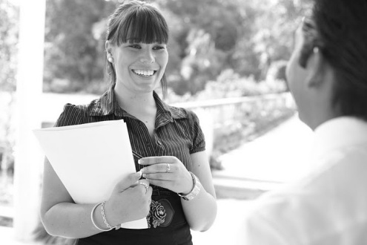
Language and tone
Language
Language refers to the choice of words that are communicated with another.
How can we ensure language is appropriate in a conversation?
Notes:
Discuss the question in the slide.

Slide 46
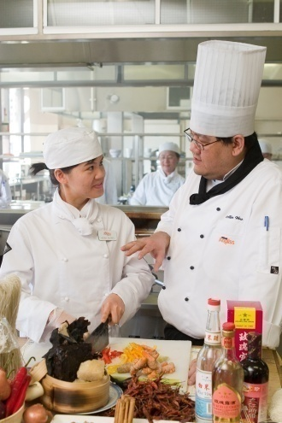
Language and tone
Tone
Not only is the choice of words appropriate, but also how it is said. This is tone
The correct use of tone of voice has a greater impact in communication than we realise
The way a message is sent is often just as important as the content and language of the message itself
Notes:
Discussion
How can you change tone?

Slide 47

Conflict and misunderstanding
What is conflict and misunderstanding?
Anything that upsets another person can be regarded as a conflict or a misunderstanding.
Notes:
Class Activity – Discussion
What are common conflicts you have in your private life?
What causes them?
How can they be solved?

Slide 48

Conflict and misunderstanding
People involved in conflict
Conflict can involve:
Groups
Individuals
Co-workers
Customers
Notes:
Class Activity – Discussion
What are common conflicts that affect these different people?

Slide 49
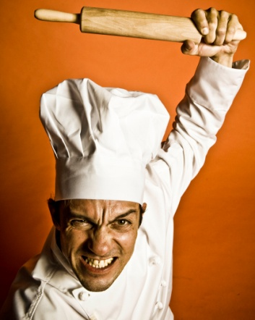
Conflict with colleagues
Some reasons include:
Pressure of work
Lack of, or bad communication
Prejudices
Ineffective working systems
Difference in opinions
Difference in beliefs
Misunderstanding
Team member not pulling their weight
Notes:
Class Activity – General Discussion
Provide some examples for each point in this slide including suggestions for reducing the conflict.

Slide 50

Conflict warning signs
Various ‘warning signs’ which may be displayed that can indicate that a problem exists or is imminent.
What are common warning signs?
What warning signs do you personally have if you have conflict with someone else?
Notes:
Class Activity – General Discussion
Discuss the questions in the slide.

Slide 51

Colleague warning signs
Avoid verbal and visual contact
Indulge in negative facial expressions
Make negative remarks
Make rude gestures or remarks
Notes:
Avoid verbal and visual contact – taking breaks in physically different areas, avoiding walking down the same corridor, asking for shifts that help avoid the chance of contact, sitting so that the other person is not in the direct line of sight
Indulge in negative facial expressions – the person may sneer your way, roll their eyes and shake their head slowly from side-to-side, or purse their lips
Make negative remarks – this can spill over into areas that are outside the initial cause of the conflict. For example, a staff member may be annoyed that you didn’t help doing the cleaning up after a function. Their perception was that you are a slacker, you are lazy and not a team player.
The truth is that the boss told you to go home because you had been at work for twelve hours that day, and were required back early the following day. The negative remarks will not stop at your perceived laziness, but will usually involve unrelated areas such as your attitude, your relationships with others, your personal habits, and so on
Make rude gestures or remarks – these can be offensive remarks (perhaps of a sexual nature), or finger and forearm gestures designed to convey a specific message.

Slide 52
Resolving misunderstandings
Actions that can help resolve the situation
This may involve you in:
Discussing the issue in a courteous manner
Speaking directly with the person concerned in a respectful way
Apologising for offence or misunderstanding that may have been caused
Taking time to talk with the person concerned
Asking for advice from the other party
Notes:
Class Activity – Discussion
Discuss points.

Slide 53
Refer issues and problems
There may be a need in your workplace to refer:
Any issues relating to cross-cultural issues
Unresolved issues
Who do you refer issues to?
When should they be referred?
Notes:
Class Activity – Discussion
Discuss questions in the slide.

Slide 54
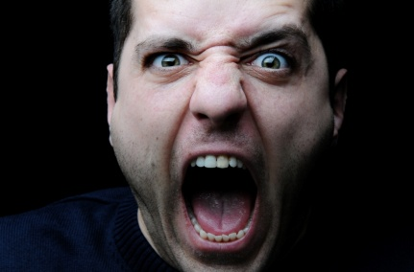
Refer issues and problems
Know when to refer issues to management
It is always important to know when and where to draw the line in relation to any cross-cultural misunderstanding.
When is it time to refer the issue?
Notes:
Class Activity – Discussion
What is ‘your line’ when it is time to stop handling a situation and to refer it to someone else?

Slide 55

Refer issues and problems
Who should problems be referred to?
Depending on the establishment, and its organisational structure, the appropriate person could be:
Colleagues
Your team leader
Your supervisor
The manager
Human Resources personnel
The owner
Members of the public
Clients
Notes:
Class Activity – Discussion
What is the protocol of referring issues?
Is the team leader or supervisor the first contact point or can you go higher?
When do you do higher?

Slide 56

Workplace documentation
What is ‘workplace documentation?
What workplace documentation do you complete?
What is the purpose of workplace documentation?
Notes:
Discuss and answer the questions.
Class Activity – General Discussion
Get the audience to list and where possible collect and discuss different types of documentation used in different departments of a hospitality business.

Slide 57

Purpose of written documentation
When identifying your purpose, determine first:
Key message you want to give your reader
Action you want your reader to make in response to your written communication
Notes:
Discuss points.

Slide 58

Written documentation
Types of common workplace written documentation includes:
Letters
Memos
Faxes
Emails
Invoices and purchase orders
Policies and procedures
Notes:
Class Activity – General Discussion
When you do use each type of written documentation?
Which is more popular and why?

Slide 59

Written documentation
Each department will have their own specific documentation.
What documentation is prepared for the following departments:
Food and Beverage
Front Office
Notes:
Answer questions in the slide.

Slide 60

Written documentation
Food and Beverage documentation
Reservations
Menus
Banquets
Conferences
Financial documents
Notes:
Reservations – including booking information, special requests, receipts and confirmation to customers
Menus – including specials of the day, menus for specific groups, drink lists and menus in different languages
Banquets – menus, schedule of events, invitations, enquiry letters, invoices, name cards
Conferences – schedule of events, enquiry letters, confirmation letters, secretarial services
Financial documents – daily checklists, sales sheets, register dockets, reconciliation sheets, breakage sheets, ‘comp’ (complimentary) sheets, forecasts and budgets.
Class Activity – Review documentation
Trainer to distribute different types of written documentation used in the F&B Department.

Slide 61

Written documentation
Front Office documentation
Activity Sheets
Registration Cards
Guest Accounts
Customer Surveys and complaint forms
Currency exchange documents
Payment forms, vouchers, letters and receipts
Notes:
Front Office
Activity Sheets – arrivals and departure sheets and VIP Lists
Registration Cards – for completion and signature by customers
Guest Accounts
Customer Surveys and complaint forms
Currency exchange documents
Payment forms, vouchers, letters and receipts.
Class Activity – Review documentation
Trainer to distribute different types of written documentation used in the Front Office department.

Slide 62

Element 2:
Participate in team assignments
Notes:
Introduce topic.
Class Activity – General Discussion
Ask general questions:
How are team roles decided?
How are individual roles and responsibilities decided?
How can a team work effectively and efficiently together?

Slide 63
Participate in team assignments
Performance Criteria for this Element are:
Identify and meet individual responsibilities within the workgroup in accordance with organisational requirements
Assist team members to ensure efficient and safe completion of assignment instructions and work tasks in accordance with legislative and organisational requirements
Communicate relevant information to team members to efficiently complete tasks in accordance with assignment goals and objectives
Notes:
Trainer identifies the Performance Criteria for this Element, as listed on the slide.

Slide 64
Participate in team assignments
Performance Criteria for this Element are:
Provide appropriate assistance to colleagues or seek as required to achieve work tasks within designated time frames
Recognise and accommodate cultural differences within the team
Notes:
Trainer identifies the Performance Criteria for this Element, as listed on the slide.

Slide 65

Identify individual responsibilities
Role of teams and individuals
Each team or group will have a purpose for its existence, with a set of objectives it is trying to achieve
Naturally each group will have people who have been chosen for a reason
Each of these people will have their own strengths and weaknesses
Notes:
Discussion & Group Activity
How are team members normally selected?
What is the benefit of having people with different strengths and weaknesses?
Group to undertake a ‘get to know each other’ game. This is designed to identify strengths of people in a group, which they may not have previously known.
Get each member to right three things about themselves they are good atr and place in a hat.
Trainer to pull out and read.
Group must try to identify the person.

Slide 66

Identify individual responsibilities
Benefits of using a team decision making approach
A more effective, operational team
A department where nothing is too much trouble
More harmony and fewer disputes amongst staff
A far better working environment
Less clock watching, and more pats on the back
More innovative and creative ideas
More learning
Higher levels of achievement
Notes:
Discussion about the benefits of group decision making
A more effective, operational team
A department where nothing is too much trouble – whether or not it is a customer or management who makes the request
More harmony and fewer disputes amongst staff
A far better working environment where you will be inclined to take less time off, and where you will actually look forward to going to work
Less clock watching, and more pats on the back – from management and patrons
More innovative and creative ideas – a situation will emerge where you are encouraged to try out new(but nonetheless intelligent ideas and concepts
More learning – not just about the establishment and the industry, but also about co-workers, group dynamics and interpersonal relationships
Higher levels of achievement than anyone thought possible – the power of ten people is far greater than 10 individuals, and there is also the momentum and power that a group decision brings with it.

Slide 67
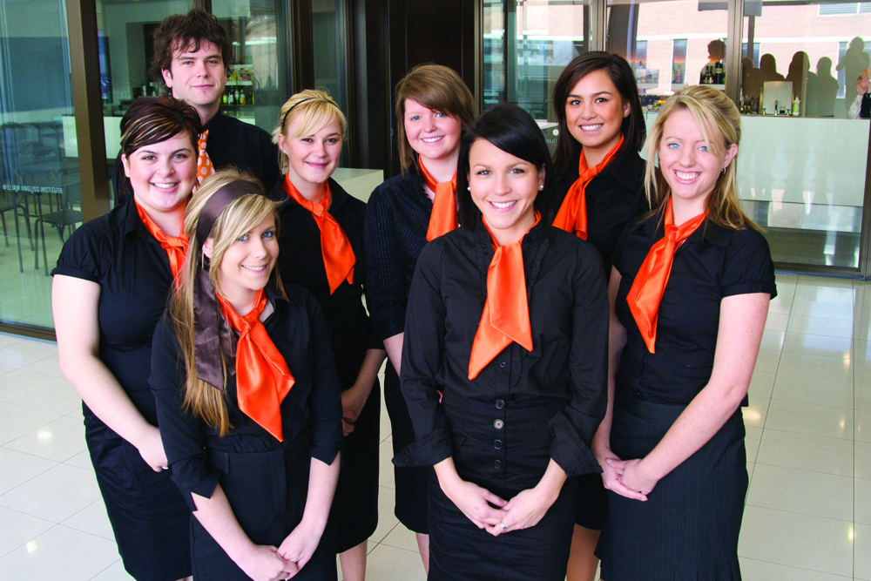
Identify individual responsibilities
Need for inclusion and cooperation
When identifying the individual roles and responsibilities, it is essential that not only do team members:
Understand what they are required to do
Accept it
Willing to take ownership
Notes:
Discussion
How can you make individuals more accepting and excited about their job and the roles and responsibilities they have?

Slide 68

Identify individual responsibilities
Identifying individual responsibilities within a group
Organisational hierarchies
Contract
Job Description
Standard Operating Procedures (SOP)
Policies
Notes:
Discussion about how to identify individual job roles and responsibilities
Trainer to provide examples of these documents for audience to review
Organisational hierarchies – each organisation will have established work groups, each with their own positions
Contract – outlines your job including any responsibilities and conditions of employment
Job Description –most jobs will have a separate job description that will identify the activities that you need to perform as part of your role
Standard Operating Procedures (SOP) – standard instructions indicating how to perform specific tasks and the order of sequence
Policies – rules to follow in an organisation relating to difference circumstances.

Slide 69

Identify individual responsibilities
Identifying individual responsibilities within a group
Procedures
Daily Task Sheets
Direct requests
Observation
Notes:
Discussion about how to identify individual job roles and responsibilities
Trainer to provide examples of these documents for audience to review
Procedures – step by step instruction detailing how to complete an activity
Daily Task Sheets – these may allocate specific tasks to perform that may relate to a specific activity or event
Direct requests – by management, colleagues or customers
Observation – quite often you will have feeling when a certain task will need to take precedence over others. This is intuition.

Slide 70

Identify individual responsibilities
Consulting with relevant others
Business owners
Management, supervisors
People from other departments
Customers
Administration staff
External suppliers
Industry bodies
Notes:
Discussion the benefits and input others can provide when identifying roles and responsibilities
Management, supervisors or business owners – who can supply input regarding staffing levels, priorities, immediate workplace need etc
People from other departments with which you have contact – these people may be management level or they may be operational staff/workers
Customers – who may be in the workplace and who have made special requests etc for the upcoming work period
Administration staff – who may provide details regarding bookings/reservations or details of other work tasks from other areas that need to be integrated into the work of your team. Administration staff may also provide necessary resources or authorisations to enable the work to be done.

Slide 71

Ensure completion of tasks
Importance of completing tasks
Within the overall context of team goals, you will have individual tasks that you will be required to complete
If you fail to complete your individual tasks then the possibility is that the team will fail to achieve its overall objectives
Notes:
Discussion
Why is it important to complete tasks?
How does it affect others if they are not done?
How can you ensure they are completed in a timely manner?

Slide 72
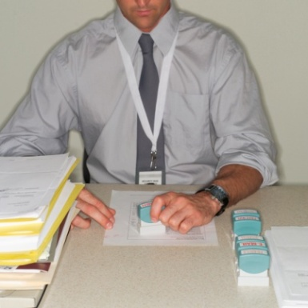
Ensure completion of tasks
Assignment instructions
Instructions from client, or supervisor, or management
Assignment objectives and timeframes
Work tasks and procedures
Resource and equipment requirements
Reporting and documentation requirements
Personal protective clothing and equipment requirements
Notes:
Discussion
Discuss these assignment instructions?
What other ones are common?

Slide 73

Ensure completion of tasks
Comply with legislative and organisational requirements
Occupational Safety and Health
Environmental issues
Quality assurance and certification requirements
Relevant industry Codes of Practice
Notes:
Discussion about complying with legal requirements
Discuss the importance of these legal requirements?
Why is it important that these are followed?
What are the consequences if they are not followed?
Occupational Safety and Health
equal employment opportunity
industrial relations
anti-discrimination and diversity
licensing arrangements
trade practices
privacy requirements
confidentiality
Environmental issues
Quality assurance and certification requirements
Relevant industry Codes of Practice
Award and enterprise agreements

Slide 74

Priortise work activities
Prioritising your tasks means that you will have to determine which tasks are the:
Most important and should be done first
Which ones can be left until later
Notes:
Class Activity – General discussion
In your past experience:
What work activities to you need to do on a daily basis?
How do you prioritise your work activities?
Are you good at managing your time?
If so, how do you do it?
If not, why not and how could you be better are it?
Do you procrastinate? Why?

Slide 75

Completing work activities
Work quickly
Practice being interrupted
Practice tact and diplomacy
Take a minute to plan and prioritise
Ask for help where required
Notes:
Tips to make this happen are:
Work quickly – get as much done as fast as possible in keeping with quality, safety, house standards or noise. The point being that you can’t afford to dawdle or waste time
Practice being interrupted – accept that many of the things you start will not be able to be completed without interruption, so work with that understanding. The fact that you get interrupted demonstrates that there are people there for you to serve. The real worry would be if you had no-one to interrupt you!
Practice tact and diplomacy – there will be instances where you simply can’t stop what you are doing to do something else, so you must develop a set of responses that lets the customer know you are busy but you will be with them very shortly
Take a minute to plan and prioritise – too many people just jump in and start their work without planning and without giving their tasks a priority order. A minute spent working out what to do first, second or third, is time well spent as it forces you to identify why tasks have the urgency you allocate to them. It makes you justify to yourself why things should be done in a certain order
Ask for help where required.

Slide 76

Encouragement and motivation
In essence motivation can be defined as ‘getting people to do something, because they want to do it’
Motivation only works when the actual people involved want to succeed
Notes:
Class Activity – Questions
What is the difference between encouragement and motivation?
How can you encourage someone? Who normally does this?
How can you motivate someone? Who normally does this?

Slide 77
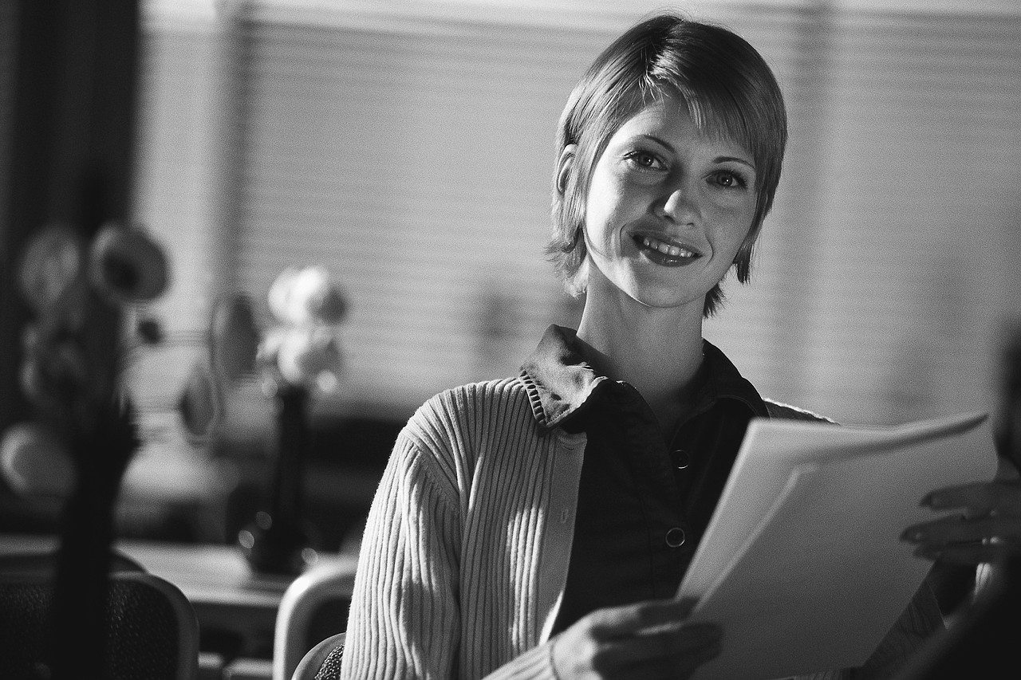
Encouragement and motivation
Methods of encouragement
Show genuine interest
Appreciate their efforts
Know the power of encouragement
Understand what encourages you and others
Appreciate the value in others
Notes:
Class Activity – Questions
How else can you encourage someone?
Show genuine interest – take the time to understand what others are doing. By understanding what they do, you can appreciate the effort they have put in
Appreciate their efforts – by knowing what people are actually doing, you can provide specific examples of great effort. This is more powerful than general appreciation
Know the power of encouragement – remember how you felt when someone encouraged you. Reciprocate this action
Understand what encourages you and others – by understanding what encourages you to perform, it can help gain an insight what might also encourage others
Appreciate the value in others – everyone has unique qualities. Remind them of their unique characteristics.

Slide 78
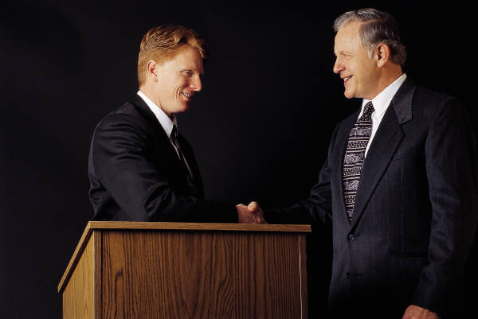
Encouragement and motivation
Methods of encouragement
Share encouraging and positive thoughts
Think of the end in mind
‘No pain, no gain’
You are in this together
Tell them how they have encouraged you
Notes:
Class Activity – Questions
How else can you encourage someone?
Share encouraging and positive thoughts – when you feel encouraged or have something positive to contribute, share it. Positivity is just as infectious and powerful as negativity
Think of the end in mind – keep reminding yourself and others, that ‘every cloud has a silver lining’. If things are tough, whether professionally or personally, keep the end in mind and keep reminding yourself and others the hard times will pass
‘No pain, no gain’ – like with all great rewards, you first have to go through an element of hardship
You are in this together – remember you are a team. What one person feels, others feel. What one person is doing, others are also doing. Help each other. No-one is alone
Tell them how they have encouraged you – if someone needs encouragement, you may like to remind them of a time when they encouraged you.

Slide 79

Encouragement and motivation
Methods of motivation:
Start by self motivation
Share information
Listen and incorporate ideas
Ownership
Set mutually agreeable goals
Notes:
Class Activity – Questions
How else can you motivate someone?
Start by self motivation – in order to motivate others, you firstly must be motivated yourself. Identify what motivates you and then start to consider what will motivate others
Share information - get people involved and give them all the facts
Listen and incorporate ideas – listen to what people have to say. The more ideas the better the chance to find the right one
Ownership – if people feel like they have some element of control and ownership over a situation, they are more likely to strive to complete a task
Set mutually agreeable goals – if everyone has a say in what is to be achieved they are more likely to strive towards the accomplishment of it.

Slide 80
Encouragement and motivation
Methods of motivation:
Keep things informal
Identify achievements
Encourage people to try
Be positive
Listen, respect and support people
Have meaningful rewards
Notes:
Class Activity – Questions
How else can you motivate someone?
Keep things informal – whilst it is important to retain structure and formality, the more you can give the appearance of informality, the more comfortable people will feel
Identify achievements – whenever achievements or milestones have been reached, let people know and celebrate success
Encourage people to try – mistakes will happen. Don’t blame people for mistakes or failures that take place if they have truly tried. You must give people the ability to try new things without fear of punishment if it doesn’t work out
Be positive – as mentioned before, the more positive you can be, with a focus on successes of individuals or groups, the more positive others will be
Listen, respect and support people – this manual is focused on the concept and importance of support. It is a truly powerful tool. If people can work together, great things are possible
Have meaningful rewards – it is important that people have something to strive for, some carrot at the end of the stick. Remember people are motivated by different things so it is important to recognise individual and groups needs.

Slide 81

Supporting team members
Importance of support in a team environment
How can managers assist team members in the completion of their work activities?
How can managers assist team members in the completion of their work activities?
Notes:
Class Activity – Questions
Discuss the questions in the slide to generate discussion.
In Section 2.4 of this manual, different ways assistance and support can be offered or received will be discussed in detail.

Slide 82
Monitoring completion of work activities
It is essential some mechanisms are put into place to monitor the progress of staff performance towards individual and team objectives
How can both management and staff monitor progress?
Notes:
Class Activity – Questions
Discuss the questions in the slide.

Slide 83
Monitoring completion of work activities
Basic techniques to monitor performance
Visual observation of staff practice
Analysis of documentation
Discussions with relevant people
Use of checklists
Notes:
Class Activity – Discuss basic techniques to monitor performance
Visual observation of staff practice – to see if their performance matches the required standards and, if not, to what degree there is a variance
Analysis of documentation – such as calculating the extent to which targets (materials cost, waste, profit, rooms serviced, labour cost etc.) have been achieved for the period in question
Discussions with relevant people – these could be other staff members, other supervisors, customers, trainers, and suppliers. Anyone impacted by the employee whose performance is being monitored are possible ‘relevant people’.

Slide 84
Monitoring completion of work activities
Use of checklists
What is the importance of checklists?
What should be included in checklists?
Who should create checklists?
How can staff use checklists?
How can management use checklists?
Notes:
Class Activity – Discussion
Discuss the questions in the slide.

Slide 85

Communicate information to team members
Whilst communication and information may primarily come from managers, it is important to remember that all colleagues within a team will communicate and share information on a daily basis.
What information do team members need?
What is the best way to communicate this information?
Notes:
Class Activity – Discussion
Discuss the questions in the slide.

Slide 86

Communication avenues
Conduct briefing sessions
What is communicated in a staff briefing?
What is communicated in a staff de-briefing?
Notes:
Class Activity – Discussion
What are the activities that are undertaken during a staff briefing / debriefing?
What information is discussed, shared or issued?

Slide 87

Communication avenues
Holding regular team meetings
Get people together
Get alignment towards a specific range of topics
Provide information
Brainstorm ideas
Exchange ideas and thoughts
Notes:
Class Activity – Discussion
Discuss the importance of these meeting topics
How often should meetings take place?
When are they normally held?

Slide 88

Communication avenues
Holding regular team meetings
Understand the topics discussed
Reach confirmation and agreement
Assign accountability and actions
Decide on further action or strategy
Notes:
Class Activity – Discussion
Discuss the importance of these meeting topics.

Slide 89

Communication avenues
Discussions
Most communication of information is often done through informal discussions between management and staff members or between team members themselves
Notes:
Class Activity – Discussion
Discuss the importance of small discussions.

Slide 90
Role of support
Support is a two way street and who provides or receives support will change depending on what is required to effectively handle each situation
It is not uncommon for one specific person to be both the provider and the recipient of support, in different situations
As mentioned, everyone has different skill sets, knowledge and experiences, and these will be called upon at different times
Notes:
Class Activity – Questions
When was a time when you provided and received support?

Slide 91

Types of support
There are a number of resources that can be used to help support a colleague including:
Physical support
Intellectual support
Financial support
Infrastructural support
Resources support
Mentoring
Notes:
Class Activity – Questions
Which type of support is most common and why?
Physical support – skill sets and actual physical help whether it be lifting, carrying, pushing or pulling
Intellectual support – frameworks, documents, files, knowledge and advice
Financial support – money needed to be able to undertake an activity
Infrastructural support – physical items including buildings, equipment, furnishing, fittings and fixtures
Resources support – food, beverages, uniforms, stationary and other supplies
Mentoring – advice and guidance

Slide 92
Providing support & assistance
What is the difference between providing ‘assistance’ and ‘support’?
Notes:
There is no set answer here but is a great discussion point to get the audience thinking about the concept.

Slide 93
Providing assistance to others
In the same way that you may need help from others, you must be similarly prepared to render assistance to others when it is called for.
What assistance can you provide?
Notes:
Class Activity – General discussion
In your past experience:
When have you given assistance to someone else before?
Why did they need it?
How did you feel when you were asked?

Slide 94
Types of assistance
Assistance is a form of support which a person can give to another and include, but is certainly not limited to:
Providing back-up support
Explaining, clarifying
Problem solving
Providing encouragement
Providing feedback to another team member
Undertaking extra tasks, if necessary
Notes:
Class Activity – Questions
What is the difference between support and assistance?

Slide 95

Providing support to others
Support and assistance is quite similar and often the two are interlinked.
Simply, where assistance may require you to undertake some activities on their behalf, support may involve:
Providing guidance
Offering encouragement
Making recommendations or suggestions for improvement
Notes:
Provide examples for each of the points.

Slide 96

Identifying need for support
Signs of identifying the need for support
Observation
Staff behaviour
Direct request from a person
Customer complaints
Productivity reports
New tasks or job role
Notes:
Class Activity – Questions
How else can you identify when someone needs support?
Observation – viewing an inability of a person to undertake job tasks or constantly making mistakes
Staff behaviour – they may be reluctant, frustrated, stressed or not motivated in starting or completing a task
Direct request from a person – whether a direct request or repeating asking for help
Customer complaints – customers may have complained about a person’s behaviour or performance
Productivity reports – reports may show that a person is unable to perform tasks to a set quality or quantity standard
New tasks or job role – new tasks and responsibilities may require staff to receive additional resources or training.

Slide 97

People who provide support
There are a number of people who will provide support to others
Support is the provision of some area of assistance or expertise one person may have which can help others complete their tasks
Notes:
Class Activity – Questions
Who provides support?
What types of support can they provide?

Slide 98
People who provide support
Owners to managers
Support departments to outlets
Managers to supervisors
Managers and supervisors to staff
Staff to staff
Staff to managers and supervisors
Customers to managers, supervisors and staff
Notes:
Class Activity – Questions
What are different types of support provided in each of these scenarios?

Slide 99

Timing and support
Our industry is one that is very much time oriented. Customers and other staff will rely on individuals to get nominated work finished by a set time
Customers expect service, food, drinks or rooms cleaned by a set time and when this doesn’t happen their satisfaction levels drop
At times, outlets have ‘rushes’ where support is needed
Notes:
Class Activity – Questions
What ‘rushes’ occur in different departments?
What times do they normally occur?
Why do they normally occur?
What support it required?
Where can it come from?

Slide 100
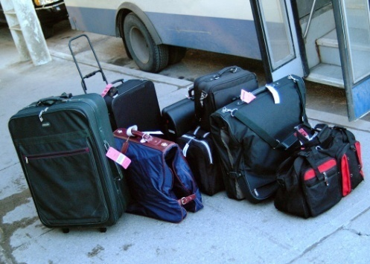
Timing and support
Examples of ‘rushes’
The arrival of a coach of tourists who all require a quick check-in and their luggage portered to rooms
A group arrival in the restaurant – all needing to be seated, supplied with their first drink, and have their order taken
A sudden rush in the retail shop
The first half hour of trade when the nightclub opens
That one day when every room service breakfast has been requested at 8.30am
Notes:
Class Activity – Questions
For each of the examples in this slide:
What times do they normally occur?
Why do they normally occur?
What support it required?
Where can it come from?

Slide 101
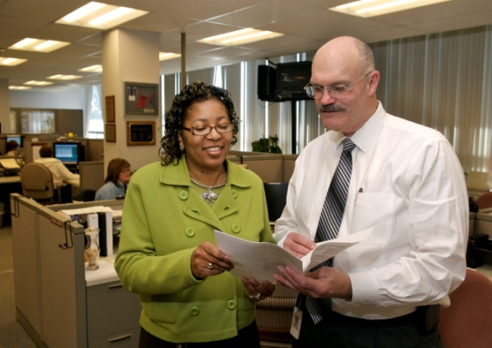
Cultural differences in teams
The hospitality and tourism industries boast staff from a variety of backgrounds.
This often means you will be working with people from different cultures.
This means to recognise and accommodate relevant cultural differences.
Notes:
Class Activity – General discussion
What is a ‘cultural difference’?
What cultural differences exist in your team (or a team in which you have been a part of)?
What problems or differences did they cause?
How were they overcome?

Slide 102
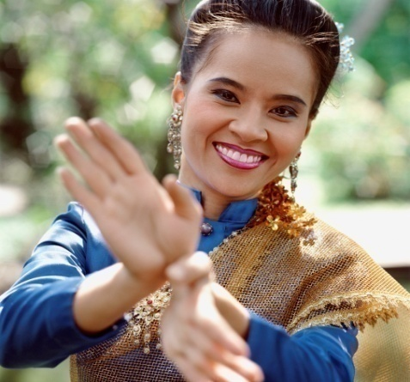
Types of cultural differences
Cultural differences may include:
Forms of address
Levels of formality, or informality
Non-verbal behaviour
Work ethics
Personal grooming
Family obligations
Recognised holidays
Special needs preferences for personal interactions
Notes:
Class Activity – General discussion
What considerations need to be recognised in relation to these cultural differences?
Provide examples of each of these cultural differences and how they can impact on a team?

Slide 103
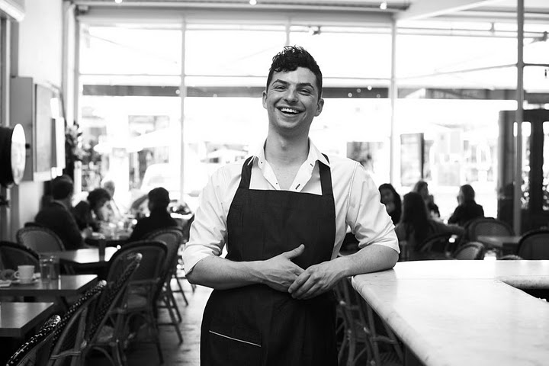
Accommodating cultural differences
Creating a climate of tolerance
Implementing team building exercises
Providing training and education
Providing mediation and counseling
Notes:
Creating a climate of tolerance within the department – that will help cushion any misunderstandings that may actually occur
Implementing team building exercises – to foster and extend trust and understanding
Providing training and education – to help make all staff more culturally aware. Cultural awareness training is a common topic in many businesses that employ people from a diversity of cultures, or where the enterprise deals with customers from a variety of cultures
Providing mediation and counseling – to assist in retrieving situations where misunderstanding occurs or conflict already exists.

Slide 104
Element 3:
Contribute to team development
Notes:
Introduce topic.
Class Activity – General Discussion
Ask general questions:
How can you contribute to the success of a team?
What makes some teams successful and more productive than others?

Slide 105
Contribute to team development
Performance Criteria for this Element are:
Meet both internal customer and external customer needs and expectations in accordance with organisation standards, policies and procedures and within acceptable time frames
Give encouragement and support to other team members to identify and organise professional development opportunities
Notes:
Trainer identifies the Performance Criteria for this Element, as listed on the slide.

Slide 106
Contribute to team development
Performance Criteria for this Element are:
Seek formal feedback and informal feedback on individual and team performance regularly from colleagues and supervisors to identify and implement improvements to products, services, processes or outcomes
Maintain personal work standards in a manner that supports the workgroup and organisational requirements
Notes:
Trainer identifies the Performance Criteria for this Element, as listed on the slide.

Slide 107
Contribute to team development
Performance Criteria for this Element are:
Make positive contributions to the planning process to improve work practices
Use non-discriminatory attitudes and language when interacting with customers, staff and management, consistently
Notes:
Trainer identifies the Performance Criteria for this Element, as listed on the slide.

Slide 108
Meeting customer needs
As a staff member, it is your role to fulfil the needs of all stakeholders of the business.
This includes both the ‘internal’ and ‘external’ customer.
Notes:
Class Activity – Questions
Picture yourself as a customer. If you were to visit a restaurant or hotel:
What needs would you have?
How can a business satisfy your needs?
Use examples from personal experience where businesses have successfully met your needs in the past. Get the audience to share their stories with each other.

Slide 109
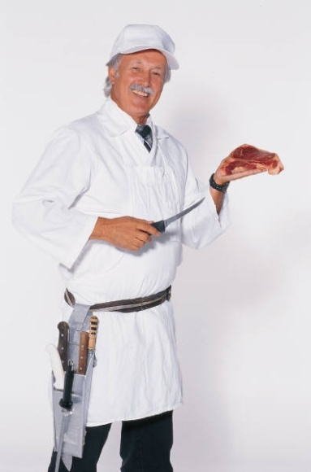
Internal customer
An ‘internal’ customer is anyone who is associated with the provision of services to customers.
In summary this includes:
Management and staff of the organisation
Suppliers and contractors who provide services to your organisation
Notes:
Class Activity – General discussion
For each of the points in this slide, identify needs each may have and how you, as a hospitality business, can meet these needs.

Slide 110
External customer
An ‘external’ customer is anyone who receives the products and services provided by the organisation.
In summary this includes:
Customers who enjoy the ‘offerings’ at the venue
Customers who enjoy the ‘offerings’ that are supplied to them, at a location not at the venue
Notes:
Class Activity – General discussion
For each of the points in this slide, identify needs each may have and how you, as a hospitality business, can meet these needs.

Slide 111

Limitations when meeting requests
Meeting needs according to legal, safety and organisational requirements
What are legal requirements that must be considered?
What are safety requirements that must be considered?
What are organisational requirements that must be considered?
Notes:
Class Activity – General discussion
Discuss the questions in the slide.

Slide 112
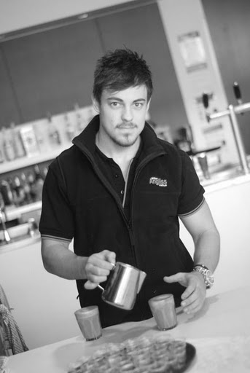
Internal customer needs
Knowledge
Skills
Training
Equipment
Time
Appropriate allocation of work
Support
Fairness
Notes:
These needs include:
Knowledge –understand and perform their job role, product knowledge, menu knowledge, external customer preferences, upcoming events, policies and procedures and schedule of events for particular shifts
Skills – the ability to practically perform selected tasks including making beds, cooking meals and checking in guests
Training – both practical and theoretical training to ensure staff skills sets are appropriate to provide quality customer service
Equipment – this can include mechanical equipment (computers, ovens, blenders) and associated tools of the trade (plates, glassware, pens, cleaning cloths)
Time – staff need adequate time to perform their tasks in the correct manner
Appropriate allocation of work – appropriate allocation of customers per staff member to be able to deliver quality service. Management must ensure adequate levels of staff are on duty to perform the necessary
Support – staff must receive support and guidance from management
Fairness – equality in areas of pay, work rate, scheduling of activities.

Slide 113
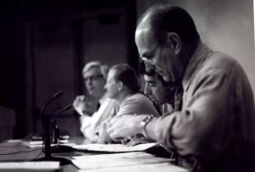
Identifying internal customer needs
In meetings, whether at a departmental or senior management level
In staff briefings at the start of a shift
During a shift as needs arise
In staff de-briefings at the end of a shift
Through comments in handover documents between shifts
Through emails, memos and telephone calls
Notes:
Discuss points.

Slide 114
External customer needs
Generic customer needs
Value for money
‘Offering’ reflecting what was advertised
Expectations met / exceeded
To feel respected
To feel welcomed
To be served by friendly staff
Notes:
Value for money
‘Offering’ reflecting what was advertised
Expectations met / exceeded
To feel respected – which is why we use “Sir” and “Madam”
To feel welcomed – which is why we give all our customers a warm, genuine and sincere smile and welcome. We really are pleased to see them
To be served by friendly staff – which is again why we smile and why we spend that extra few seconds with them, talking about how their day went and so on

Slide 115

External customer needs
Generic customer needs
To be dealt with in a prompt and courteous manner
To receive assistance when necessary
To be in comfortable, clean surroundings
To feel remembered and recognised
To be heard and understood
Notes:
To be dealt with in a prompt and courteous manner – which is why we don’t keep them waiting at reception, the bar, for room service, meals etc
To receive assistance when necessary – which is why we have excellent product and local knowledge and why we look for opportunities to pass this on to them whenever we can, even without their having to ask
To be in comfortable, clean surroundings – which is why we make sure the facilities, rooms, grounds and equipment are spotless
To feel remembered and recognised – which is why we use the customer’s name as often as we can
To be heard and understood – which is why we listen to complaints and adopt the role of their advocate whenever there is a complaint, problem or dispute. We want to fix their problems, not create new ones.

Slide 116

External customer expectations
Customers have perceived expectations of what level of service they expect when visiting a venue arising from:
Past visits
Advertisements and promotional messages
Competing hotels
Industry standards
Comments from family, friends and colleagues
Price charged for the offering
Notes:
Discuss points.

Slide 117

Specific target market needs
Each target market in your business has their own unique needs.
What are the needs for the following market segments:
Business
Women
Family
Leisure
Elderly
Groups
Notes:
Business – computer and internet access, newspapers, executive lounges, laundry services, business or executive centre, business and news channels. Business men are more likely to frequent a hotel bar and eat in the restaurant
Women – hairdryers, larger mirrors, healthier food options, specific bathroom amenities, fashion magazines, bath. Business women are more likely to use the gym and eat room service
Family – interconnecting rooms, costs, entertainment options, child care facilities, children’s television programs, package deals and safety
Leisure – cheaper rates, local attractions, concierge services
Elderly – single beds, medical facilities, suitable food options and cheaper rates
Groups – need for large allocation of rooms, cheap rates, meeting rooms, specialised menus, bus access and parking.
Class Activity – General discussion
Are there any other major market segments that exist?
What needs do they have?

Slide 118

Identifying external customer needs
Staff must be pro-active and try to anticipate the needs of customers where possible.
This can be achieved through:
Observation
Asking questions
Putting yourself in the shoes of the customer
Notes:
Class Activity – General discussion
For each of the points in this slide, identify using examples how needs can be identified.

Slide 119

Special needs customers
Customers who come to us with special needs may be categorised as:
Disabled
Unable to speak local language
Having other special needs
Notes:
Class Activity – General discussion
What are common ways a hotel can meet the needs of ‘special needs customers’?

Slide 120
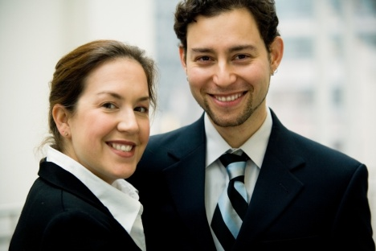
Special needs customers
Customers who are unable to speak local language
Use gestures
Prepare multi-lingual documents and signs
Employ bi-lingual staff
Notes:
Attempts at gestures may include:
Pointing to indicate a location
Holding fingers up to establish quantities
Rubbing your hands to indicate temperature
Nodding your head in agreement
Shaking your head in disagreement
Using facial expressions to relay your feelings
Removing adjectives (descriptive words) from your speech
Slowing your speech down and speaking clearly and concisely
Avoiding using local idiom or slang.
Where possible documents should be printed in a variety of languages to enable customers to understand information relating to the property and the surrounding region. The printing of a selection of documentation in various languages should include, but not be limited to:
Information compendium
Emergency procedures
Menus.

Slide 121

Professional development opportunities
One of the key characteristics of successful teams is the ability to recognise and provide training and development opportunities to staff.
What training and development opportunities exist?
Notes:
Discussion
What are the benefits of providing these for:
Owners
Managers
Staff members themselves
Customers.

Slide 122
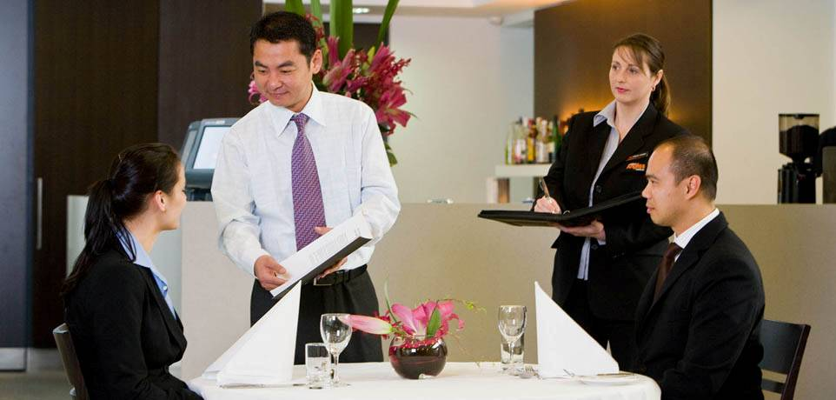
Professional development opportunities
Developing the ‘skill set’
All team members must have the opportunity to improve their ‘skill set’ which aims at the development of:
Knowledge
Skills
Attitudes
Notes:
Discussion
Trainer to discuss the difference between these
Identify examples of different training sessions and how each of these points are developed
What is the best way to ‘develop’ each of these points?

Slide 123
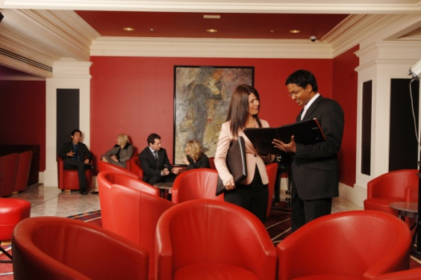
Professional development opportunities
Staff training and staff development
Staff training will be applied to address a need that has some immediacy to it
Staff development has more of a future orientation and relates to skills and knowledge the staff member may need at some future date
Notes:
Discussion
What are the benefits of each of these approaches?
What are examples of development programs for each of these?

Slide 124

Professional development opportunities
Professional development
Staff development is often referred to in another name: ‘Professional development’
What are examples of ‘professional development’ activities?
How do you select people?
Notes:
Discussion
Discuss the questions in the slide.

Slide 125

Professional development opportunities
Access to professional development
‘Professional development’ activities tend to have some ‘future focus’
In many cases, professional development activities:
Are provided for staff as a department-wide or organisation-wide activity
Are targeted for individual staff to prepare them for a future role
Notes:
Discussion
What are examples of programs suited to:
Whole organisation or department?
Individuals or small groups?
Are provided for staff as a department-wide or organisation-wide activity – for example, all staff may be required to participate in a professional development activity on ‘time management’
Are targeted at one (or more) individual staff to prepare them for a future role – such as promotion, to replace another staff member who is taking leave, to learn how to undertake new tasks associated with the introduction of a new product/service to the venue.

Slide 126
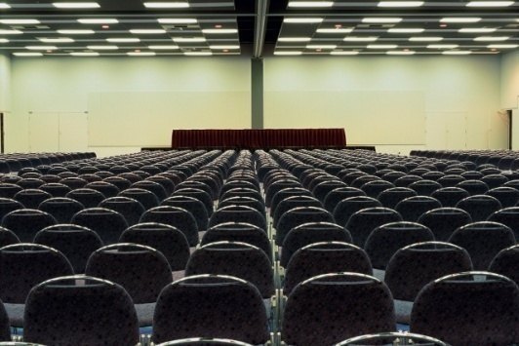
Professional development opportunities
Internal or external professional development
Professional development activities can be:
Conducted on the premises:
by management/the supervisor
by an external third party provider
Conducted off the premises
Notes:
Discussion
What are the benefits of each?
What are examples of each?

Slide 127

Professional development opportunities
Types of professional development opportunities
Internal training and professional development
External training and professional development
Coaching
Mentoring
Supervision
Formal and/or informal learning programs
Notes:
Discussion
Identify each type of professional development opportunity
When would it be beneficial?

Slide 128
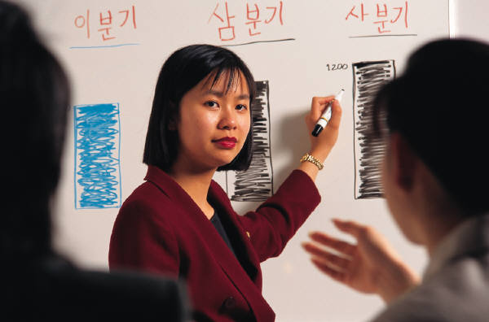
Professional development opportunities
Types of professional development opportunities
Work experience and exchange opportunities
Personal study
Career planning and development
Performance appraisals
Workplace skills assessment
Quality assurance assessments and recommendations
Change in job responsibilities
Notes:
Discussion
Identify each type of professional development opportunity
When would it be beneficial?

Slide 129
Professional development opportunities
Types of professional development opportunities
Opportunity for greater autonomy or responsibility
Formal promotion
Chance to perform in a higher position in a caretaker mode
Becoming a mentor for someone
Leading a training session
Being sent to a conference
Notes:
Discussion
Identify each type of professional development opportunity
When would it be beneficial?

Slide 130

Mentoring
It is a relationship between two people where a more experienced person works in collaboration with a less experienced person to give the less experienced person the benefit of their:
Knowledge
Experience
Perspective
Contacts
Insight
Wisdom
Notes:
Discussion
Why is mentoring such a popular professional development activity?
What is the purpose of mentoring?
What are the benefits?
How long should the mentoring process last?

Slide 131
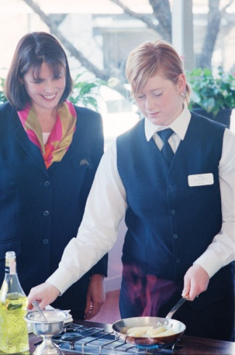
Coaching
This is where you deliver on-the-job training to individuals and groups using a wide range of training options.
What training options exist?
Notes:
Discussion
Discuss the question in the slide.

Slide 132
Coaching
Coaching options
Demonstrations
Discussion
Lectures
Case studies
Role-plays
Games
Notes:
Discussion
Discuss the different coaching options as identified in this slide.

Slide 133

Coaching
Coaching options
Exercises
Excursions
Guest speakers
Presentations
Providing explanations
Problem-solving
Notes:
Discussion
Discuss the different coaching options as identified in this slide.

Slide 134
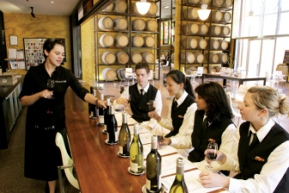
Formal and informal learning programs
Formal learning
An externally provided course
An internal non-accredited training course
Informal learning
Less structured programs
Greater flexibility
As required
Notes:
Discussion
What is the different between these two approaches?
What are the benefits of each?
What are examples of formal and informal learning programs?

Slide 135

Other development programs
Other professional development programs
Personal study
Work experience
Job rotation
Notes:
Discussion
What are these approaches?
What are the benefits of each?

Slide 136

Support materials
Support materials for professional development programs
Manuals
Exercises
Take away notes
Role plays
Catering
Management representatives
Notes:
Discussion
When are these support materials best utilised?

Slide 137

Support materials
Support materials for professional development programs
Case studies
Self evaluation tools and questionnaires
Exercises relevant to the topic
Enterprise policies and procedures
References
Books, magazines, web sites
Notes:
Discussion
When are these support materials best utilised?

Slide 138

Feedback from team
From time to time your colleagues will provide you with feedback and information. For them not to do this would mean they are not doing their job.
This feedback and information can be:
Positive
Negative
Neutral
Notes:
Class Activity – General discussion
In your past experience:
What type of feedback is the most common? Why?
What are some examples of each type of feedback you have received?

Slide 139
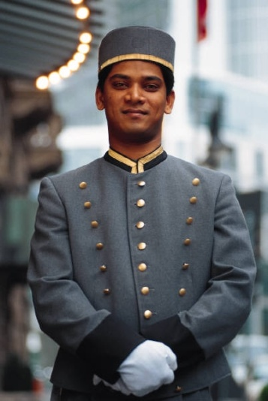
Positive feedback
Positive feedback can involve team members passing on a comment they have heard about your excellent service.
You should take a second or so to rejoice in such feedback
Accept it and enjoy it because you’ve earned it
Never simply dismiss it or brush it off
Never say something like “Oh, it was nothing”, or ‘Just doing my job’
Thank the person
Notes:
Class Activity – General discussion
In the past, describe times when you have received positive feedback.
How did it feel to receive it?

Slide 140

Negative feedback
Take the negative feedback in the right way:
See it as an opportunity to improve
Don’t dwell on the negative message
Don’t shoot the messenger!
The keys are to:
Listen to the criticism
Determine objectively if there is truth in it
Work out how to rectify things
Notes:
Class Activity – General discussion
In the past, describe times when you have received negative feedback.
How did it feel to receive it?

Slide 141
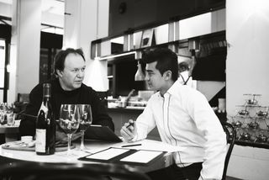
Neutral feedback
Neutral information can occur when staff members deliver up-dates or new information about what’s happening
The result of this information is usually that you will need to factor it into your work and the priorities you have already set
Notes:
Class Activity – General discussion
In the past, describe times when you have received neutral feedback.
How did it feel to receive it?

Slide 142
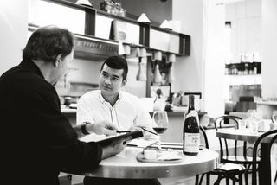
Collecting feedback
Formal Feedback:
Customer comment cards
General Manager cocktail parties
Interviews and follow up calls
Meetings
Performance reviews
360-degree assessment
Team evaluations
Workplace assessment
Notes:
Customer comment cards – these are established documents aimed at getting responses to a wide range of questions covering all facets of an operation
General Manager cocktail parties – this approach involves selected guests enjoying refreshments with senior management. It is common for management to ask questions about their stay and suggestions for improvement. This approach is also beneficial in finding out more about the customer, which can be used to provide more personalised service
Interviews and follow up calls – at times management may contact customers to find out about their experiences or visits
Meetings – staff meetings are held on a regular basis and normally will explore the performance of operations. At these meeting, comment cards from customers are discussed with strategies for improvement implemented
Performance reviews – this approach is used by management when providing feedback to staff regarding their performance. During these reviews, management will also ask staff for their suggestions or recommendations for improvement. At times, causes of poor staff performance will identify faults in the operation (lack of training, understaffing, limited or faulty equipment) which can be improved.

Slide 143

Collecting feedback
Informal Feedback:
General discussion
Observations
Critical incident reviews
Impromptu questioning of customers
Coaching and mentoring
Personal, reflective behaviour strategies
Notes:
This approach is a very effective way to get feedback. This information may come in the form of ‘gossip’ or ‘through the grapevine’, however is the provider of the largest amount of feedback.
Informal feedback involves collecting information and feedback outside the above mentioned formal avenues. This includes:
General discussion – whether with fellow staff or with customers, by interacting with people, you can get a good feel of what people are thinking
Observations – this is a great form of feedback. It is encouraged that staff observe the actions and reactions of customers and fellow staff. Most people are often uneasy about truthfully giving negative feedback, so this approach is useful in getting an accurate reading of what people are thinking in different situations.

Slide 144

Maintain personal work standards
Individual team members:
Should have personal pride in their work
Produce an outcome that they feel is of value and worth
Have a personal set of standards in which they strive to obtain
Notes:
Questions
Why is it important to have personal work standards?
What are examples of work standards you would have?

Slide 145
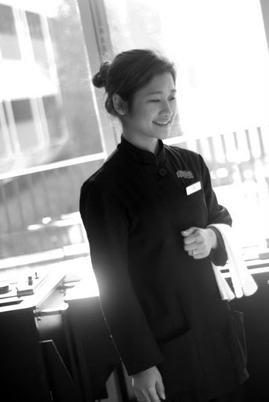
Maintain personal work standards
Common personal work standards
Have a strong work ethic
Undertake all their responsibilities, roles and tasks
Work to the best of their ability
Work in a professional manner
Maintain professional and hygienic grooming and deportment standards
Notes:
Discussion
Discuss these personal work standards.

Slide 146
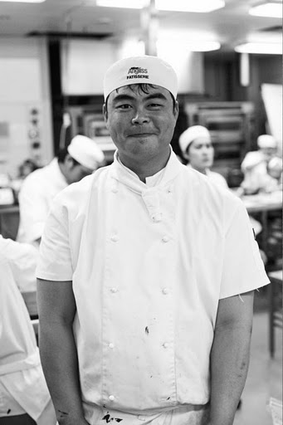
Maintain personal work standards
Common personal work standards
Work in compliance with all organisational, legal and safety obligations
Strive to learn and improve
Be helpful, sensitive and supportive
Be flexible in their approach
Notes:
Discussion
Discuss these personal work standards.

Slide 147

Make positive contributions in planning
Involve staff in planning activities
Central to the operation of any successful business is the need to prepare for what lies ahead and to plan what is going to happen
As staff members are actively involved in the operations, it is essential that they are encouraged to provide ideas and suggestions aimed at improving work practices
Notes:
Discussion
Why is it important to involve staff in the planning process?
How can you involve them?

Slide 148
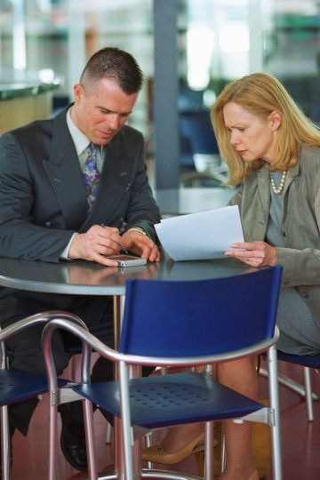
Make positive contributions in planning
Areas for planning
Sales targets
Performance targets for a particular project
Increased productivity
Achieving KPIs
Organisational strategies
Operational activities
Task management
Contingency management
Notes:
Discussion
Discuss the points in the slide.

Slide 149

Make positive contributions in planning
Encourage positive staff contributions in the planning process
Positive contributions when planning should address all aspects of work including:
Policies
Procedures
Practices
Notes:
Discussion
What input would you want staff to contribute?

Slide 150

Non-discriminatory attitudes and language
All staff must be aware of the differences that exist between all stakeholders of the organisation.
A hospitality business is truly ‘international’ and has many ‘differences’:
Backgrounds
Beliefs
Religions
Cultures
Countries
Notes:
Things that one person may regard as ‘normal’, ‘acceptable’, ‘likeable’ or even ‘preferable’ can be, and frequently are, very different to what customers from different countries expect.
Class Activity – General discussion
Get audience members to discuss differences that exist when dealing with people from different countries, using the points in this slide as a guide.

Slide 151
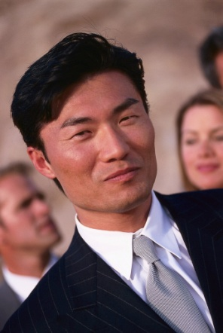
Expectations of overseas customers
Customers from other countries and cultures could have differing views in terms of:
Customer expectations
Levels of formality and informality
Appropriate non-verbal behaviour
Communicating sincerity
Dress and appearance
Notes:
Discuss points based on self experience.

Slide 152
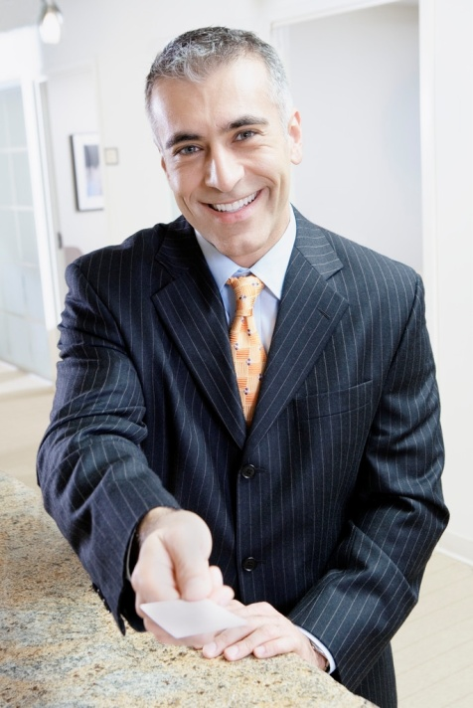
Non-discriminatory attitudes and language
Culturally-based communication differences
Politeness and respect
Be formal and direct
Using the guests’ correct names and titles, pronounced correctly
Notes:
Discuss points.

Slide 153

Non-discriminatory attitudes and language
Establishment organisation
Bilingual staff
Documents in different languages
Supplying food and beverages found in their home countries
Providing news, newspapers and magazines
Having homeland music available
Selection of staff from different cultural backgrounds
Notes:
Class Activity – General discussion
What can a hotel do to cater for it’s international market? Use this question as the basis of a group activity.
Break the group into pairs and get each pair to identify 5-10 things they can do to cater to an international market.
As a trainer, to make the activity more challenging, you may allocate each group a country or market segment.

Slide 154

Non-discriminatory attitudes and language
Language difficulties
Speak clearly
Speak at normal volume
Avoid idiomatic language
Give the guest your full attention
Notes:
Class Activity – General discussion
How do you communicate with someone who doesn’t speak the same language as you?

Slide 155

Non-discriminatory attitudes and language
Non-verbal communication and messages
Body language
Gestures
Eye contact
Smiling
Non-verbal communication means different things in different cultures.
Notes:
Class Activity – General discussion
What are points to consider when using each of the points mentioned in this slide when working in an ‘international’ environment?

Slide 156

Non-discriminatory attitudes and language
Stress
Stress occurs in both customers and in staff who are serving them.
What stresses do visitor’s have?
What stress does staff have?
How can you reduce these stresses?
Notes:
Visitors are often under a great deal of stress. They are in a foreign land, confronted with an alien language and not having even the basic day-to-day working knowledge that everyone simply takes for granted.
And the staff who deal with them are also usually a bit stressed by the normal work routine, plus the challenge of having to cope with a difficult situation.

Slide 157

Revision and Assessments
It is now time to complete any:
Revision
Activities
Assessments
Notes:
Class Activity – Revision and Assessments
Explain Revision and Assessments.
Trainer to give audience time to undertake Revision and Assessments.

